Slide 1

Project 4 Predicting Bank Churn for customers
Lucie Mullany
Olive McKenzie
Siobhan Brindley
Abdul-Kareem Abdul-Rahman

Slide 2

Project Scope
A bank is looking to reduce customer churn by implementing a churn predictor tool.
What will it be used for?
What outcome are we hoping for?
Notes:
A bank is looking to reduce customer churn by implementing a churn predictor tool.
What will it be used for? The tool would allow customer service reps to input key details about a customer before speaking with them, and then use machine learning to predict the likelihood of that customer churning.
The goal is to enable reps to proactively address any issues or concerns a customer may have, and hopefully retain the customer before they decide to leave the bank.
Objective - The bank hopes that this tool will lead to increased customer retention and ultimately improved financial performance.

Slide 3
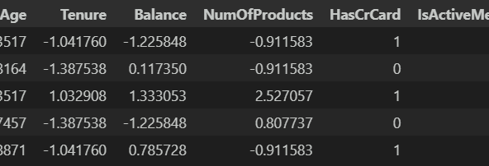
Cleaning and Preparing the Data
Missing values and unnecessary columns were dropped
One Hot Encoding was used on Categoric Variables
Standard Scaler was applied to Numeric Values

Slide 4
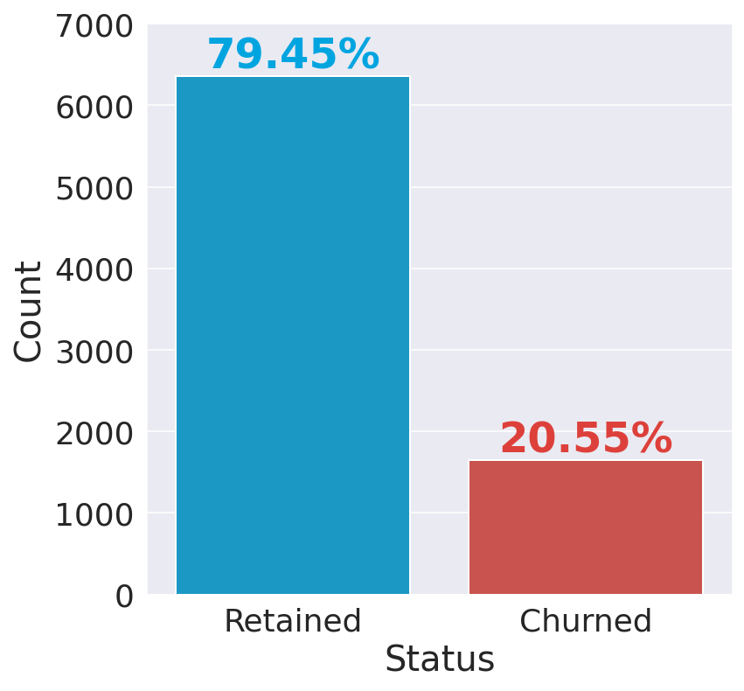
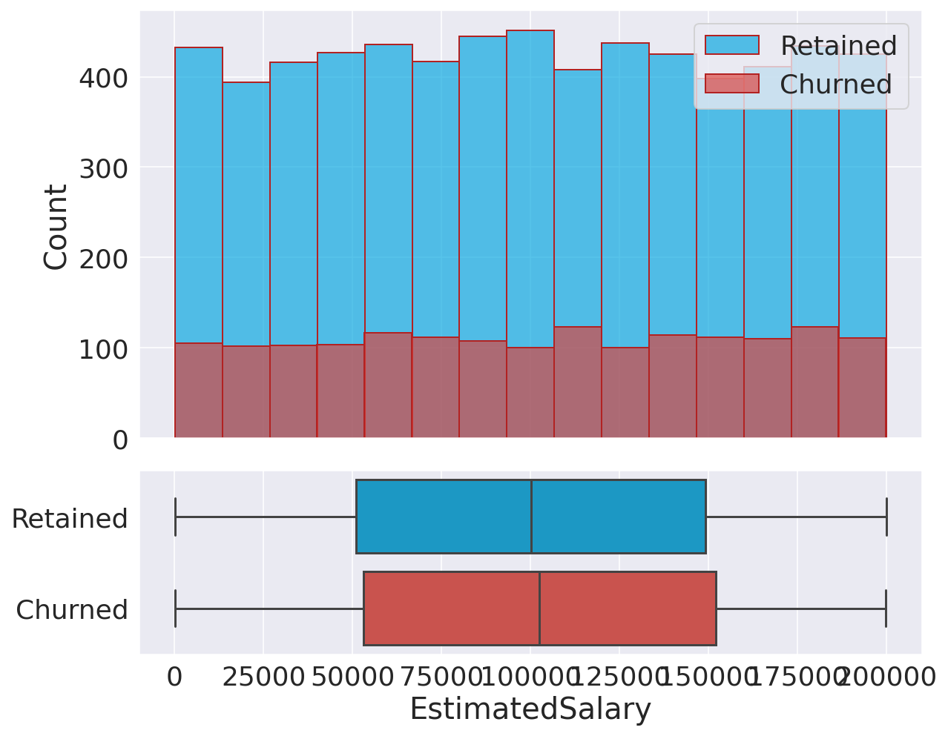
Dataset Insights
We produced some graphs for a better insight into our data

Slide 5

Machine Learning Methods
Logistic Regression
KNN
Decision Trees
Random Forest

Slide 6

KNN
Model Performance without and with hyperparameter optimisation

Slide 7
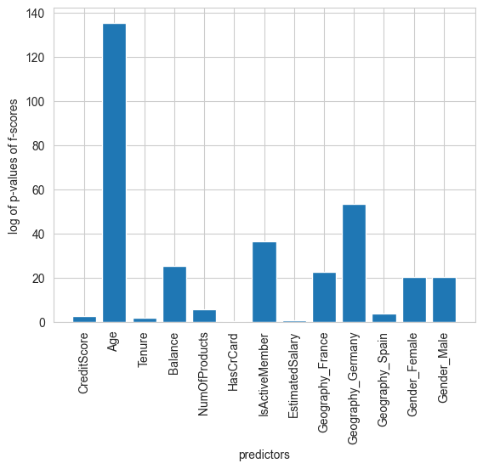
Predictor Graph
The predictor graph shows age is the biggest influence on churn

Slide 8
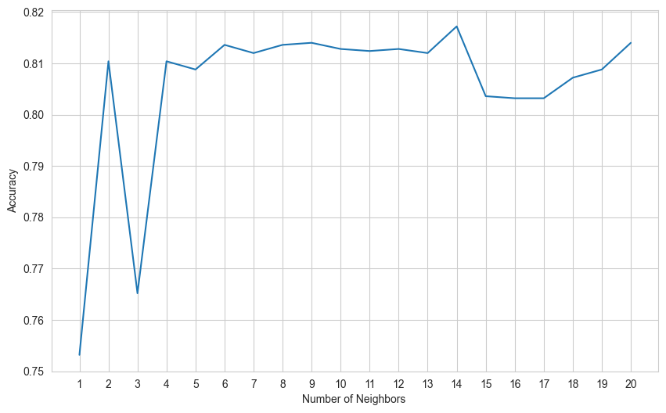
Elbow Graph

Slide 9
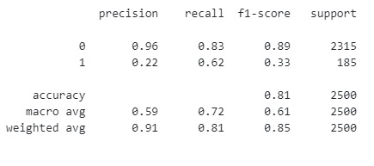
Non optimised model

Slide 10

Optimising the best KNN model
Perform hyperparameter optimisation
from sklearn.model_selection import GridSearchCV
grid_params = { 'n_neighbors' : [5,7,9,11,13,15],
'weights' : ['uniform','distance'],
'metric' : ['minkowski','euclidean','manhattan']}
gs = GridSearchCV(KNeighborsClassifier(), grid_params, verbose = 1, cv=5, n_jobs = -1)
g_res = gs.fit(X_train_2, y_train)
identify the best parameters based off the optimisation
g_res.best_params_
{'metric': 'minkowski', 'n_neighbors': 15, 'weights': 'uniform'}

Slide 11
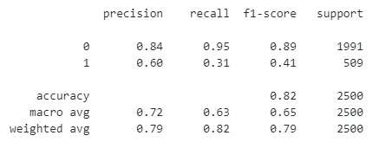
Optimised Model Results

Slide 12

Logistic Regression

Slide 13
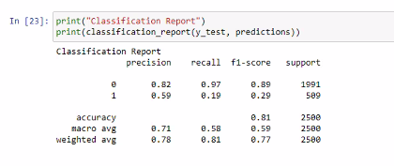
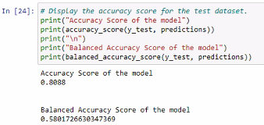
Initialising the model
Dropped the Customer ID and exited columns
Accuracy Score for first model 81%

Slide 14
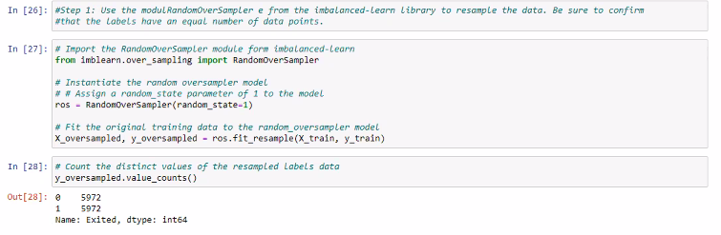
Resampling the Data
Used the module RandomOversampler from the imbalanced-learn library to resample the data

Slide 15
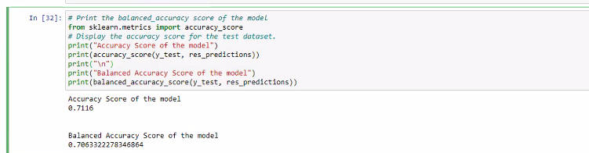
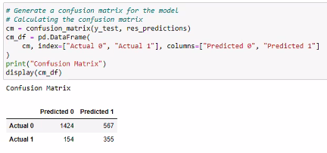
Resampled Data Results
The accuracy score of the rebalanced data was 71%

Slide 16
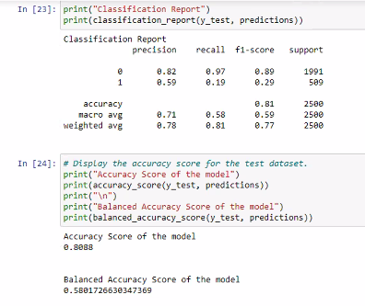
Final Optimised Results
The final accuracy score was 80.88%

Slide 17

Decision Tree Classifier

Slide 18
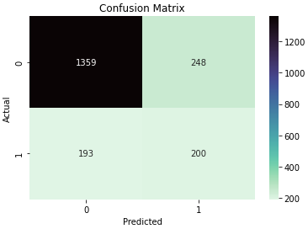
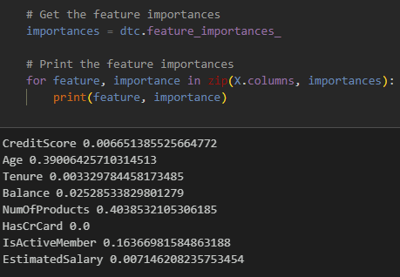
Decision Tree Classifier
Initial Decision Tree had an accuracy score of 77.95%
 | precision | recall | f1-score | support
Not Churned | 0.88 | 0.85 | 0.86 | 1607
Churned | 0.45 | 0.51 | 0.48 | 393
Reducing the number of features in the model increased the accuracy to 79%
Notes:
The precision for class 0 (customers who didn't churn) is 0.88, which means that out of all the customers predicted as not churning, 88% actually didn't churn.
The recall for class 0 is 0.85, which means that out of all the customers who actually didn't churn, the model correctly identified 85% of them.
The F1-score for class 0 is 0.86, which is the harmonic mean of precision and recall. It takes into account both metrics and provides a balanced score.
The precision for class 1 (customers who churned) is 0.45, which means that out of all the customers predicted as churning, only 45% actually churned.
The recall for class 1 is 0.51, which means that out of all the customers who actually churned, the model correctly identified 51% of them.
The F1-score for class 1 is 0.48.
The overall accuracy of the model is 0.78, which means that it correctly predicted the churn status of 78% of the customers.
The macro average of precision, recall, and F1-score is 0.66, 0.68, and 0.67 respectively. The macro average treats each class equally and doesn't take into account class imbalance.
The weighted average of precision, recall, and F1-score is 0.79, 0.78, and 0.78 respectively. The weighted average takes into account class imbalance and is influenced more by the larger class (class 0 in this case).
The precision for class 0 (customers who didn't churn) is 0.88, which means that out of all the customers predicted as not churning, 88% actually didn't churn.
The recall for class 0 is 0.85, which means that out of all the customers who actually didn't churn, the model correctly identified 85% of them.
The F1-score for class 0 is 0.86, which is the harmonic mean of precision and recall. It takes into account both metrics and provides a balanced score.
The precision for class 1 (customers who churned) is 0.45, which means that out of all the customers predicted as churning, only 45% actually churned.
The recall for class 1 is 0.51, which means that out of all the customers who actually churned, the model correctly identified 51% of them.
The F1-score for class 1 is 0.48.
The overall accuracy of the model is 0.78, which means that it correctly predicted the churn status of 78% of the customers.
The macro average of precision, recall, and F1-score is 0.66, 0.68, and 0.67 respectively. The macro average treats each class equally and doesn't take into account class imbalance.
The weighted average of precision, recall, and F1-score is 0.79, 0.78, and 0.78 respectively. The weighted average takes into account class imbalance and is influenced more by the larger class (class 0 in this case).
The precision for class 0 (customers who didn't churn) is 0.88, which means that out of all the customers predicted as not churning, 88% actually didn't churn.
The recall for class 0 is 0.85, which means that out of all the customers who actually didn't churn, the model correctly identified 85% of them.
The F1-score for class 0 is 0.86, which is the harmonic mean of precision and recall. It takes into account both metrics and provides a balanced score.
The precision for class 1 (customers who churned) is 0.45, which means that out of all the customers predicted as churning, only 45% actually churned.
The recall for class 1 is 0.51, which means that out of all the customers who actually churned, the model correctly identified 51% of them.
The F1-score for class 1 is 0.48.
The overall accuracy of the model is 0.78, which means that it correctly predicted the churn status of 78% of the customers.
The macro average of precision, recall, and F1-score is 0.66, 0.68, and 0.67 respectively. The macro average treats each class equally and doesn't take into account class imbalance.
The weighted average of precision, recall, and F1-score is 0.79, 0.78, and 0.78 respectively. The weighted average takes into account class imbalance and is influenced more by the larger class (class 0 in this case).
The precision for class 0 (customers who didn't churn) is 0.88, which means that out of all the customers predicted as not churning, 88% actually didn't churn.
The recall for class 0 is 0.85, which means that out of all the customers who actually didn't churn, the model correctly identified 85% of them.
The F1-score for class 0 is 0.86, which is the harmonic mean of precision and recall. It takes into account both metrics and provides a balanced score.
The precision for class 1 (customers who churned) is 0.45, which means that out of all the customers predicted as churning, only 45% actually churned.
The recall for class 1 is 0.51, which means that out of all the customers who actually churned, the model correctly identified 51% of them.
The F1-score for class 1 is 0.48.
The overall accuracy of the model is 0.78, which means that it correctly predicted the churn status of 78% of the customers.
The macro average of precision, recall, and F1-score is 0.66, 0.68, and 0.67 respectively. The macro average treats each class equally and doesn't take into account class imbalance.
The weighted average of precision, recall, and F1-score is 0.79, 0.78, and 0.78 respectively. The weighted average takes into account class imbalance and is influenced more by the larger class (class 0 in this case).

Slide 19
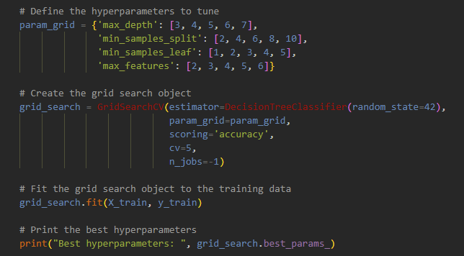
Grid Search CV
Best hyperparameters:
- max_depth : 5,
max_features: 6
min_samples_leaf: 1
min_samples_split: 6

Slide 20
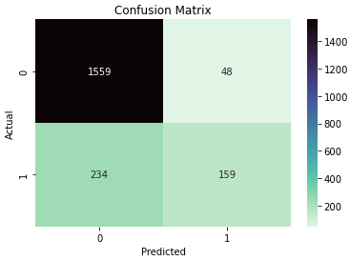
Tuned DTC
The final Model had an Accuracy score of 85.90%
 | precision | recall | f1-score | support
Not Churned | 0.87 | 0.97 | 0.92 | 1607
Churned | 0.77 | 0.40 | 0.53 | 393
Notes:
Precision for class 0: 0.87, meaning that 87% of customers predicted as not churning actually didn't churn
Recall for class 0: 0.97, meaning that 97% of customers who actually didn't churn were correctly identified by the model
F1-score for class 0: 0.92, a balanced score that takes into account both precision and recall
Precision for class 1: 0.77, meaning that 77% of customers predicted as churning actually churned
Recall for class 1: 0.40, meaning that only 40% of customers who actually churned were correctly identified by the model
F1-score for class 1: 0.53
Overall accuracy: 0.86, meaning that the model correctly predicted the churn status of 86% of customers
Macro average of precision, recall, and F1-score: 0.82, 0.69, and 0.72 respectively, treating each class equally and not accounting for class imbalance
Weighted average of precision, recall, and F1-score: 0.85, 0.86, and 0.84 respectively, taking into account class imbalance and influenced more by the larger class (class 0)

Slide 21


Random Forest

Slide 22
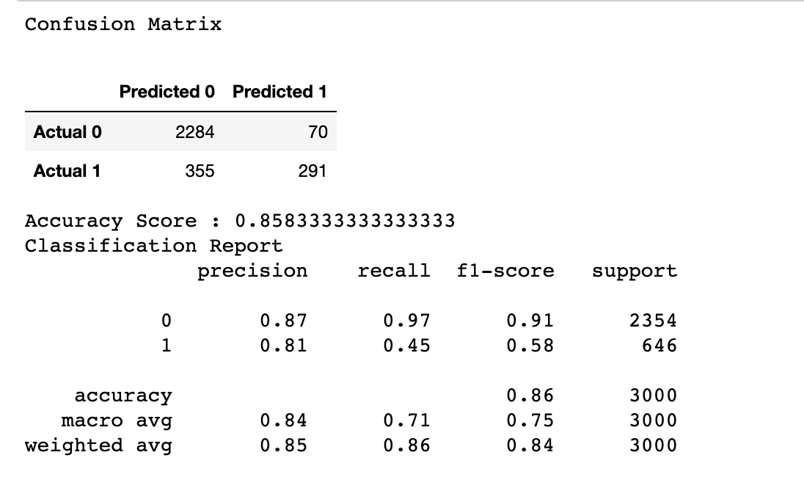
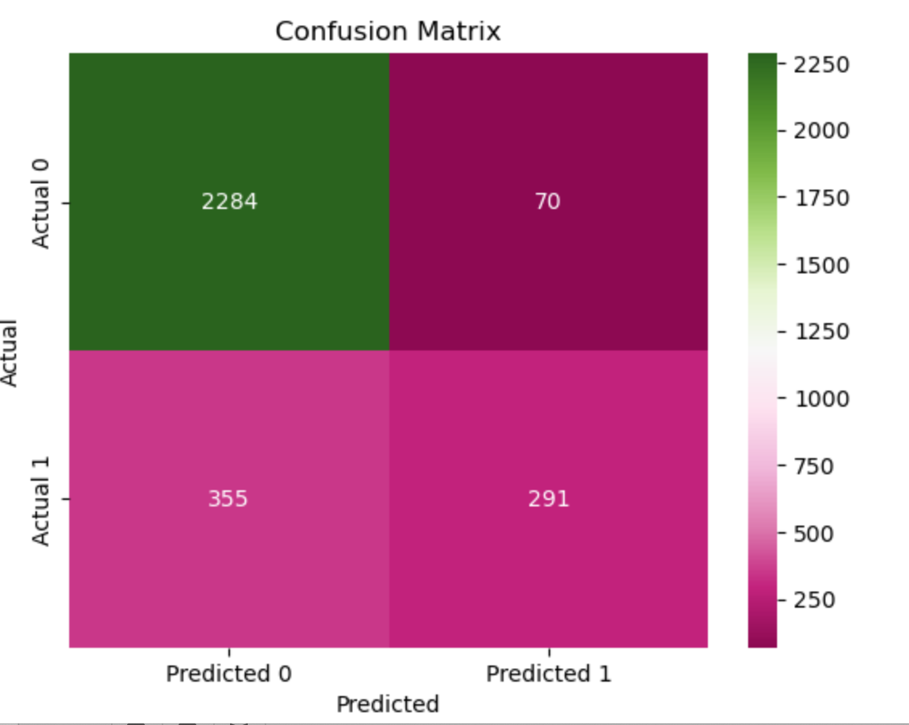
First run through
Our first model had an accuracy score of 85.8%
Notes:
First run through – Precision score of 87% Recall 97% f1-score of 92% for 0
Precision score of 81% Recall 46% f1-score of 58% for 0

Slide 23
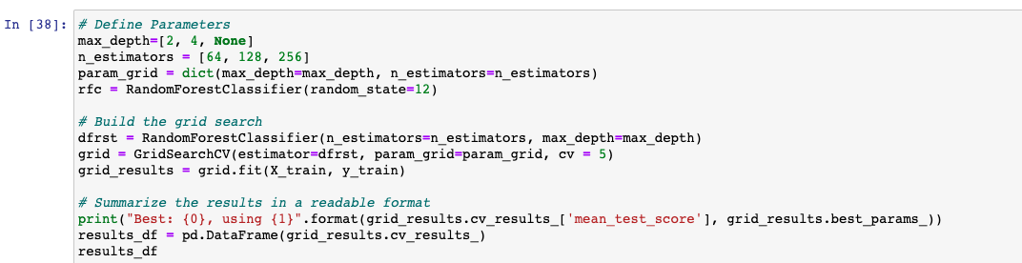
Using GridSearch CV
We then used GridSearch CV to optimise the model to get the best possible accuracy score

Slide 24
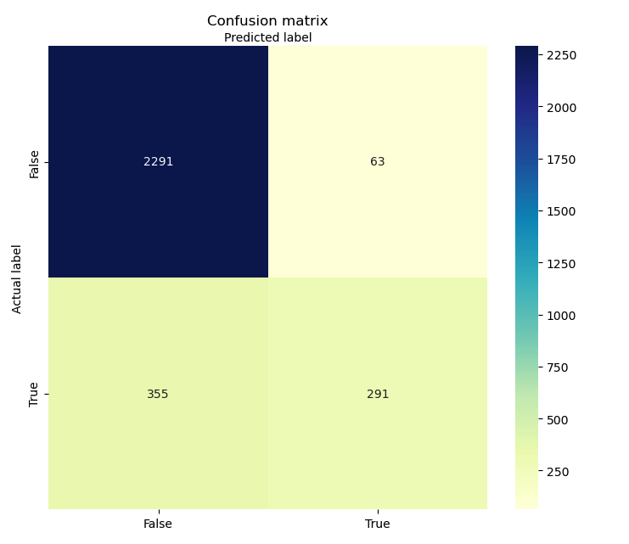
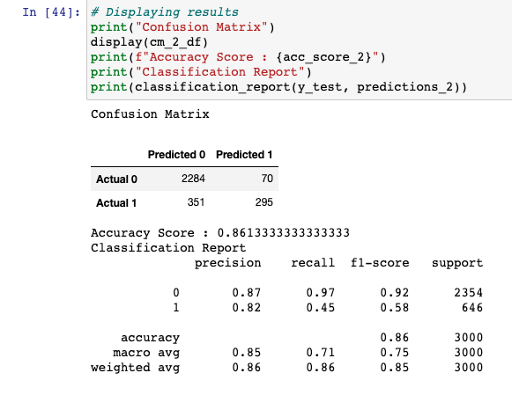
Final Optimised Model
The optimised model produced an accuracy score of 86.13%

Slide 25
Final Model Selection
Logistical Regression
81.0%
KNN
84.6%
Decision Tree
85.9%
Random Forrest
86.1%
Among the four algorithms, Random Forest yielded the highest accuracy score and had the best recall for the Churn class.

Slide 26

Among the four algorithms, Random Forest yielded the highest accuracy score and had the best recall for the Churn class.
Therefore, based on our experimental results, we can conclude that Random Forest outperformed the other three algorithms in terms of accuracy and recall.

Slide 27
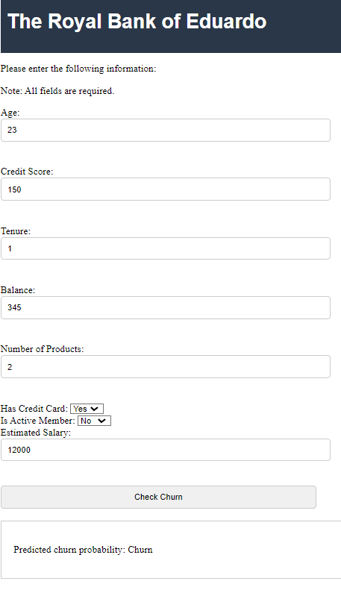
User Interface
User Sends Customer Data
Flask Receives a POST request
Loads the Model from a File
Predicts the Churn and returns the result as JSON

